Slide 1
Software Engineering and Architecture
Exercise in REST

Slide 2
Level 2 REST
The ‘CRUD on resources’ to model state transitions, I admit, takes a bit of time to get your head around ☺.
We will try a small exercise, closely related to Webber et al.’s How to GET a cup of Coffee blog post
Get hold of the ‘coffeeshop.zip’ from the weekplan.
Most info is also available in the README.md in the zip.
Notes:
Interal HBC note: Codebase is bit bucket project 'frsproject', on branch saip-e18-coffeeshop-exercise.

Slide 3
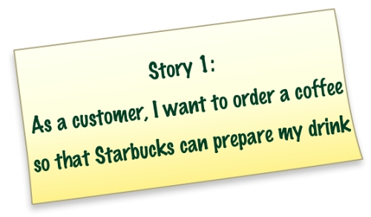
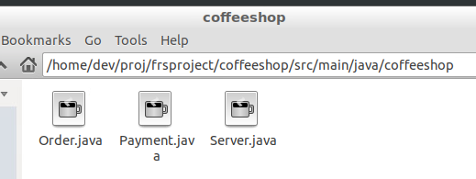
Story 1
I have already implemented Story 1.

Slide 4
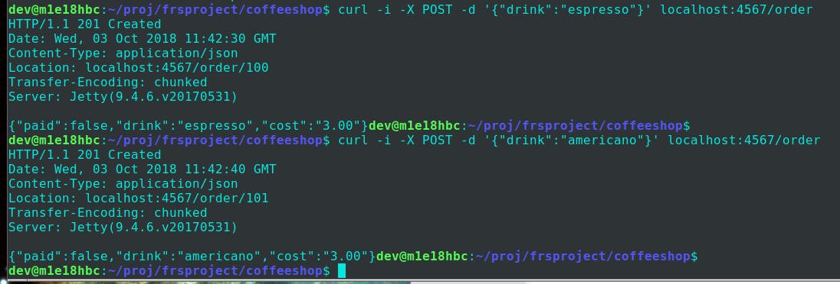
Story 1
Our highly user-friend client is ‘curl’ as usual ☺
Sorry to folks that like clicking with a mouse…

Slide 5
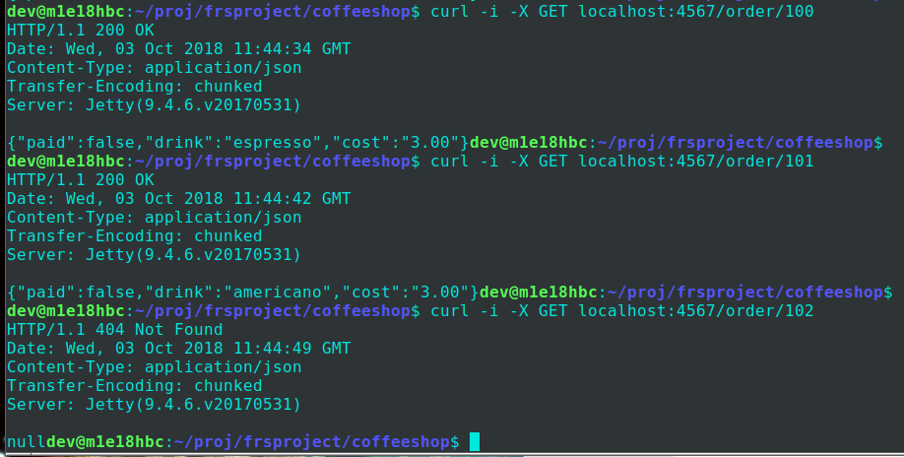
Story 1
Review order by GET

Slide 6
Your Exercise

Slide 7
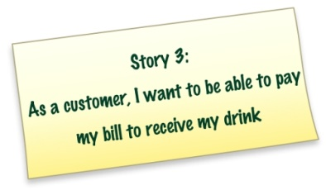
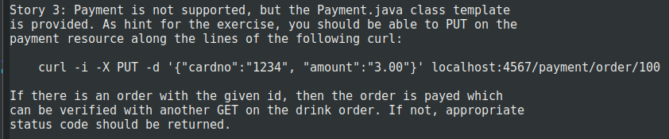
Implement Story 3
Allow paying for the coffee
I.e. a state transition for the coffee order
HATEOAS: You update a resource that represents the transition
Suggestion: payment/order/{id}
Simplification:
No next/links section, we just assume URI /payment/ exists
Note: Also change state of order to ‘paid’!

Slide 8
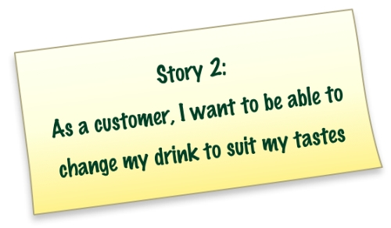
Implement Story 2
Implement the PUT, as outlined by Webber et al.

Slide 9
Add Stuff
Validate proper payment, etc.
Use correct status codes as return values

